Slide 1
Intelligent Low-Altitude Air Traffic Management System
Group 30
Members:Humaid Al-Kaabi
Jun An Tan
Saad Alsudayri
Suhail Aldhaheri
Client/Advisor: Professor Peng Wei

Slide 2
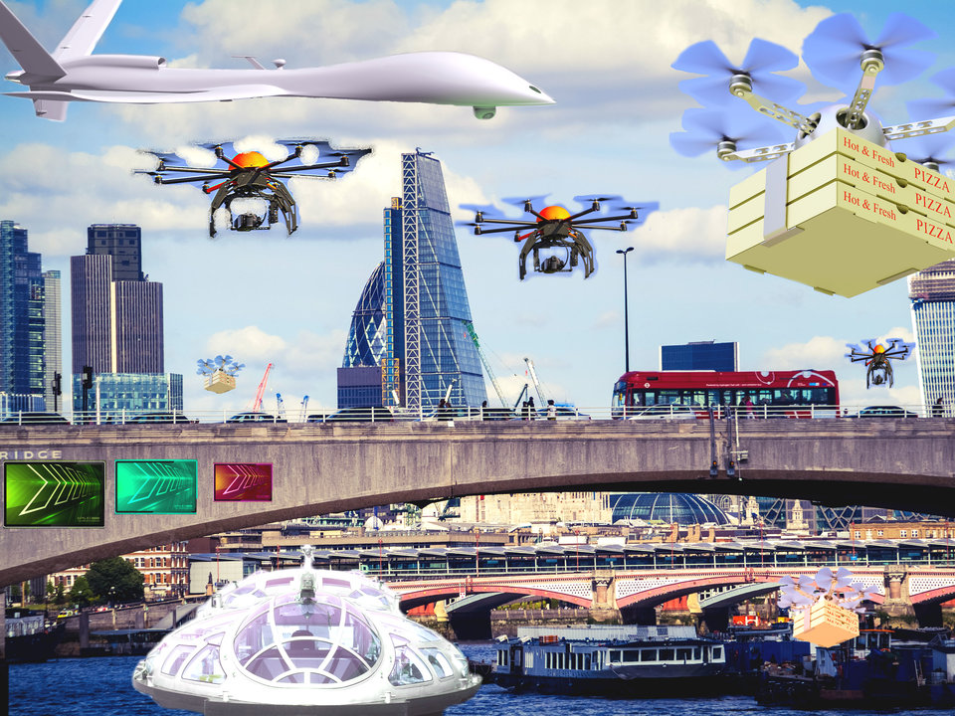
Problem Statement:
With the increase number of low altitude aircrafts used in deliveries, it became necessary to have a management system that puts the downsides such as the increase number of collisions, energy waste and delivery costs into consideration.

Slide 3
Solution:
Create a software that allows low altitudes aircrafts users to simulate and analyze different delivery scenarios and conclude the best cases that reduces the disadvantages in deliveries. For example, placing a warehouse in a strategic location that could eventually reduce the cost of operation for drones.

Slide 4
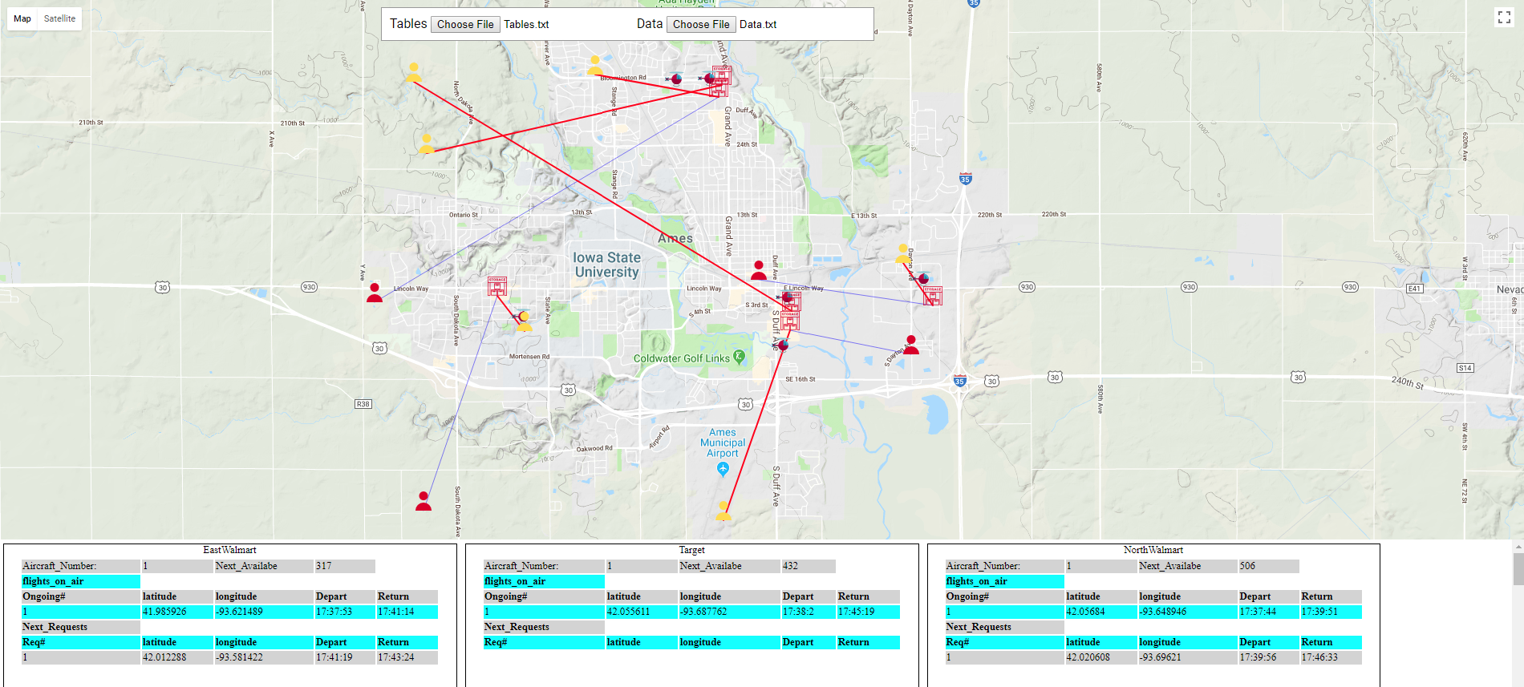
Introducing the Software
For a given warehouses information and simulation type, the software can simulate the delivery process for a given order rate/number of customers and show the relative data needed to conclude the advantage and disadvantage of the location of the warehouse and number of aircrafts used.

Slide 5
Requirement, limitations and assumption:
Requirements:
Multiple warehouses.
Different number of aircrafts.
Limitations and assumptions:
Fixed altitude.
Straight path from warehouse to customer and going back.
Assuming each warehouse has unlimited supply.

Slide 6
Choosing Programming languages:
Calculations: Java.
Object oriented programming language.
Display: JavaScript, HTML and CSS
Google Maps JavaScript API
Has all the tools needed to display the data.
Notes:
Talk about why we chose Java, easy to build templates for the warehouses and flights

Slide 7
Design Approach:
Create classes - (Store Data)
Warehouse: location - number of aircrafts - average loading/dropping time.
Trajectories: start and end location/time - current location.
etc..
Create General Methods
Calculate time, distance, position on air, ...etc .
Update, add, remove, keep track, ...etc.
Check for conditions such as time overlap, trajectory crossing ... etc
Create Simulation Methods
Based on shortest time.
Based on shortest distance.
Based on clear trajectory.

Slide 8
Design Approach:
User input:
Warehouse info
Name, Location, Number of Aircrafts
Request generation:
Area, rate of demands generation
Simulation type:
Distance, time, clear trajectory.
Other settings - (fixed for all)
Loading and dropping average time.
Aircrafts speed.

Slide 9
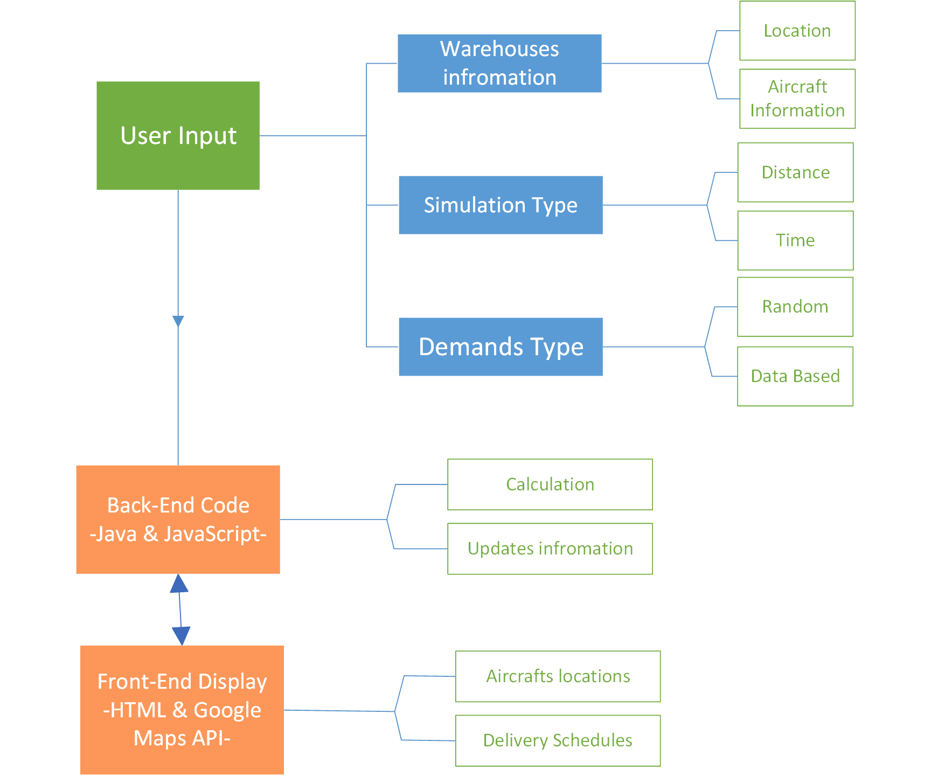
Design Approach

Slide 10
Simulation types - Shortest Distance
Aircraft speeds:
200m/s (unrealistic - just for simulation)
Request:
Random.
One boundary.
Rate 40 request/minute
Loading and dropping:
2 seconds

Slide 11
Simulation Type - Shortest Time with possible trajectory crossing
Aircraft speeds:
200m/s (unrealistic - just for simulation)
Request:
Random.
One boundary.
Rate 40 request/minute
Total of 10 customers.
Loading and dropping:
2 seconds

Slide 12
Simulation Type - Shortest Time with no trajectory crossing
Aircraft speeds:
200m/s (unrealistic - just for simulation)
Request:
Random.
One boundary.
Rate 40 request/minute
Total of 10 customers.
Loading and dropping:
2 seconds

Slide 13
Simulation Type - Shortest Time with no trajectory crossing
Multiple regions with different rate of order

Slide 14
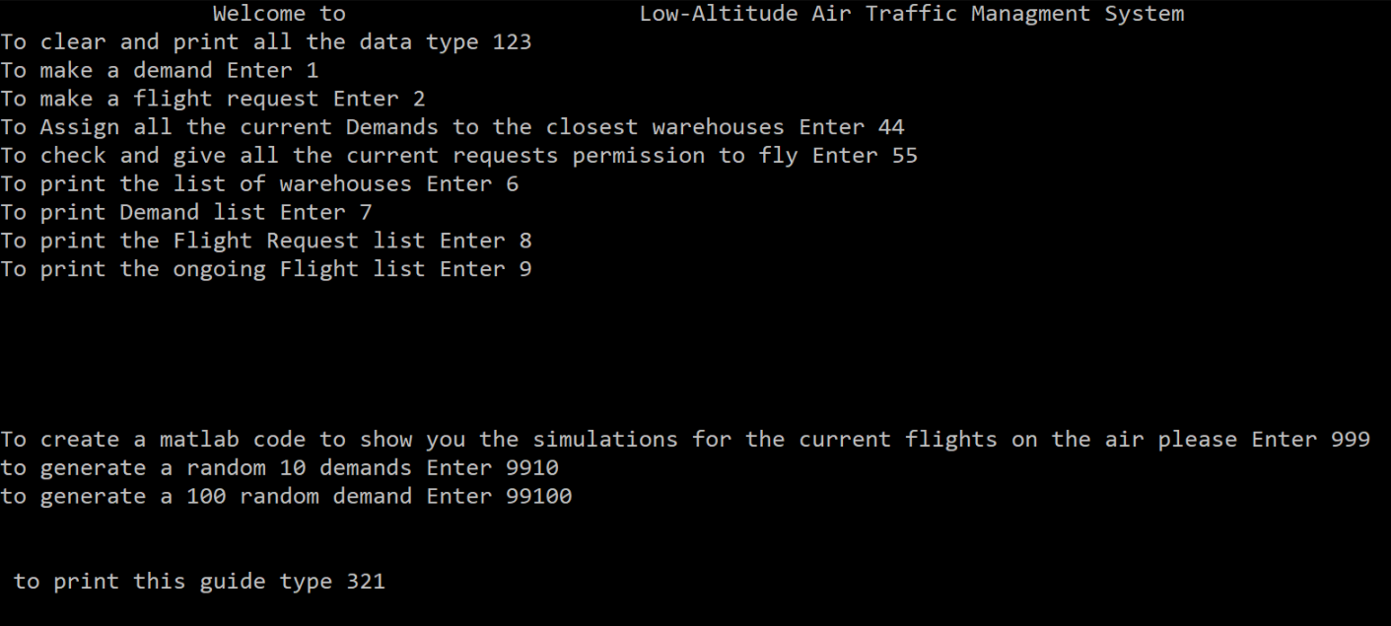
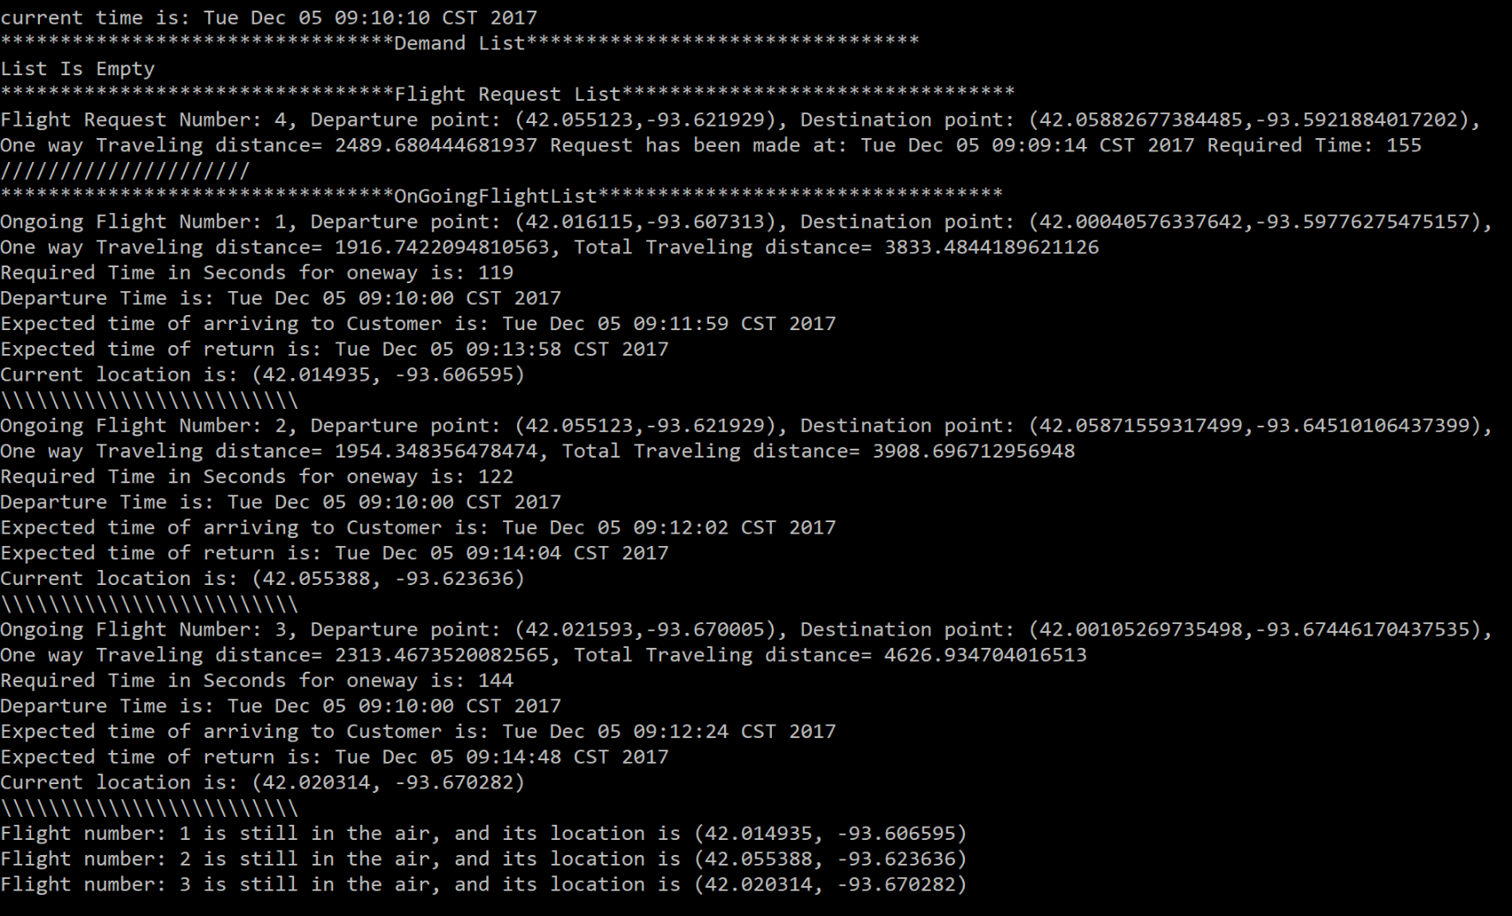
Progress timeline
First semester prototype:
No display.
One aircraft per warehouse.
Warehouse numbers and locations were fixed to what in the source code.
No loading - dropping package time.
Requests generation was limited to Ames.
Notes:
To Jun An: here you need to talk about how we started our software and what the disadvantages we faced and why we improved them

Slide 15
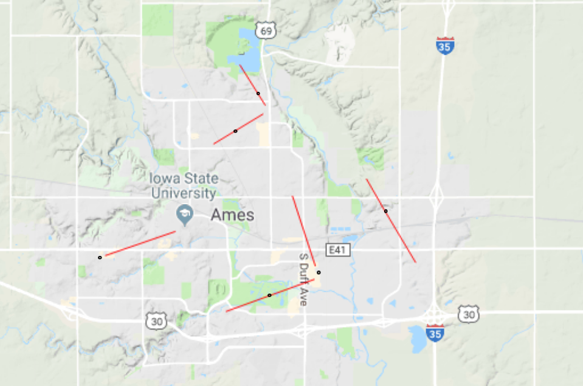
Progress timeline
Second/Third prototypes:
Required using of AJAX and jQuery.
Required using server to update the data.
Required a lot of inputs.
No way to use symbols.
No table to represents data.
Notes:
To Jun An, you can say that in these prototypes we just started to learn about JS, CSS and HTML.

Slide 16
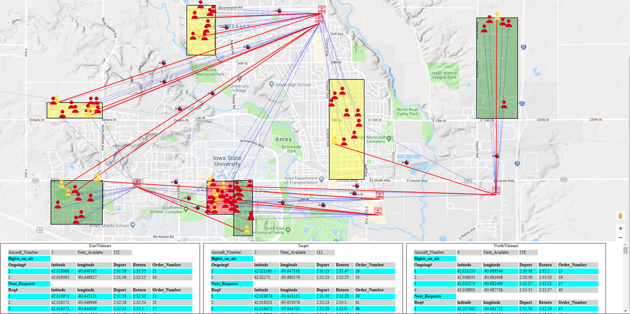
Progress timeline
Final Version:
Symbols for each piece of information the user might be interested in.
Easy data transfer between the codes.
Tables that show all the data user need to keep track of.
Notes:
To Jun An, just explain how the the final version look like.

Slide 17
Problems and Solutions
Display:
Problem: could not find the proper way to display our data.
Solution: Google Maps JavaScript API.
Data Transfer:
Problem: find a way to connect the data between Java and the display.
Solution: write and read using text files.
Notes:
To Suhail,
1- talk that in the beginning of the semester we did not know how we can display our data. Then mention we did separate researches on Java JavaScript Matlab and other online tools and we concluded that google maps will be the best solution since it has all the tools we need.
2-talk about what we did first, using AJAX and jQuery and creating local server, but then talk about your method in reading the text files

Slide 18
Challenges
No sufficient experience in programming.
We are Electrical Engineers
Limited time to create more kind of simulation
Notes:
1- mention that we are 4 EE and we only two of us had experience in Java and non of us had previous knowledge in CSS JS nor HTML.

Slide 19
Questions?

